Slide 1
Internet safety
Hints and tips

Slide 2
topics
Settings
Hub/router settings
Device settings – iphones/ipads/Xbox
App settings
Game settings
Useful websites
Things to remember
questions

Slide 3
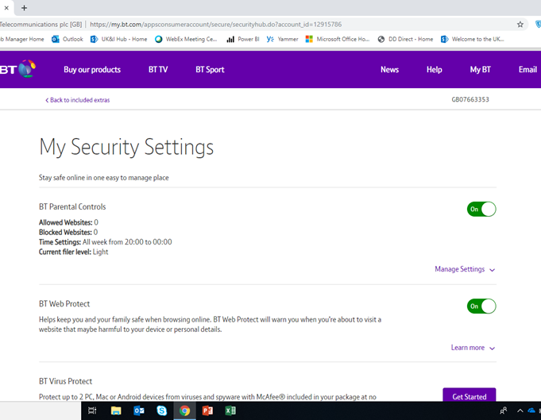
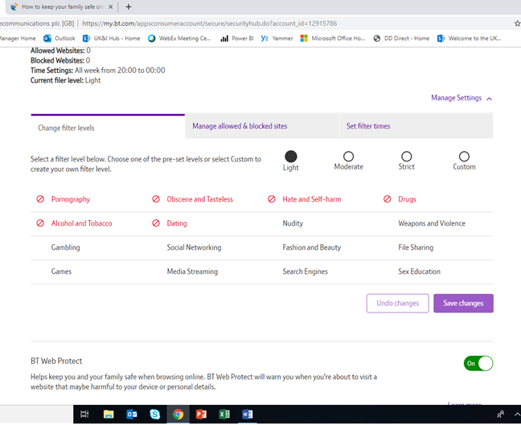
Hub/router settings
These can be any type of hubs provided by your isp (internet service provider) many allow you to control different levels of
Screen time
Websites
Content
Log on to your online account and navigate to your account settings, look for “privacy”

Slide 4
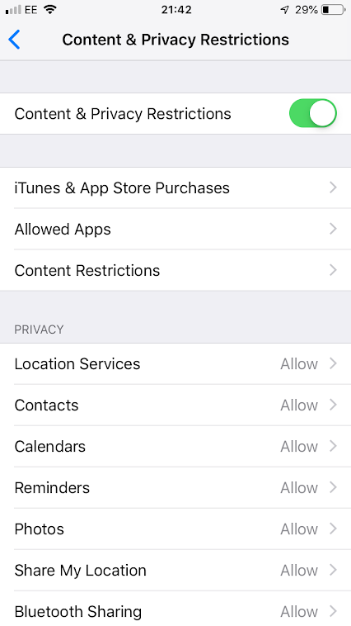
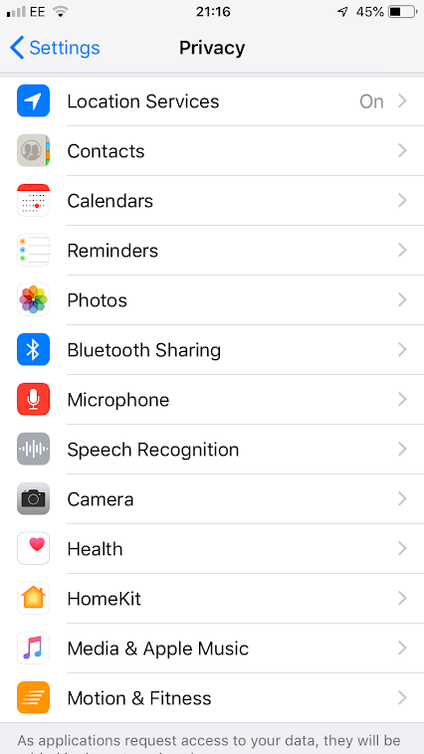
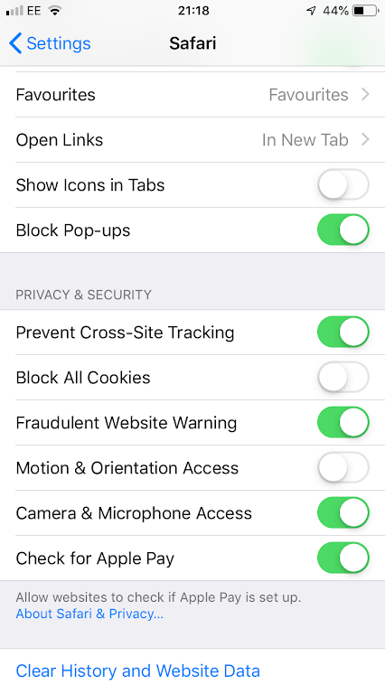
Device settings
Iphones/ipads – Privacy settings

Slide 5
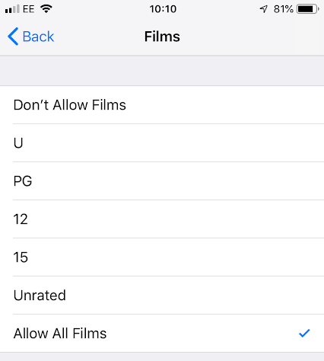
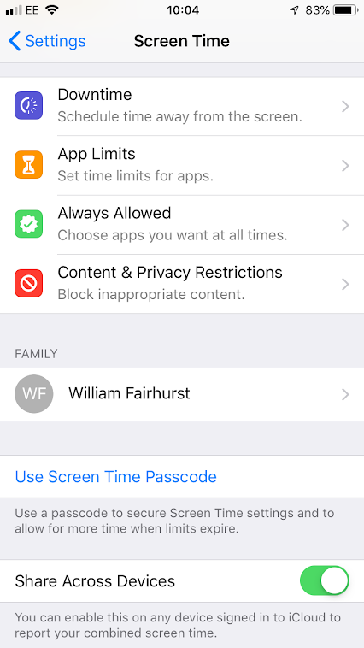
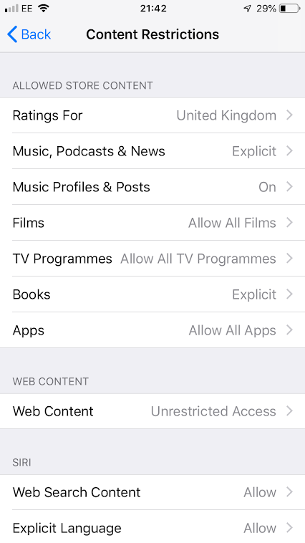
Device settings
Iphones/ipads – content restrictions

Slide 6
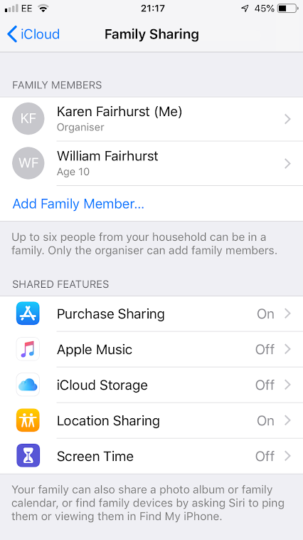
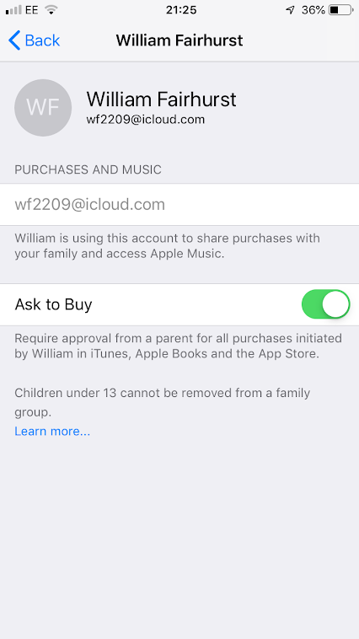
Device settings
Iphones/ipads – family sharing
This is really good feature of apple accounts. Can enable features like
Extra controls on app downloads and purchases.
Sharing of appropriate content
Finding lost phones
Setting screen limits
Setting downtime.

Slide 7

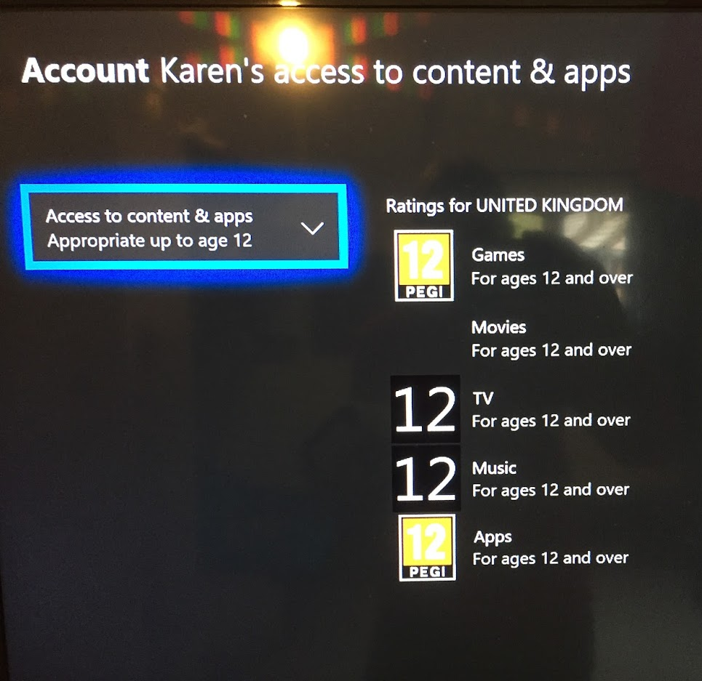
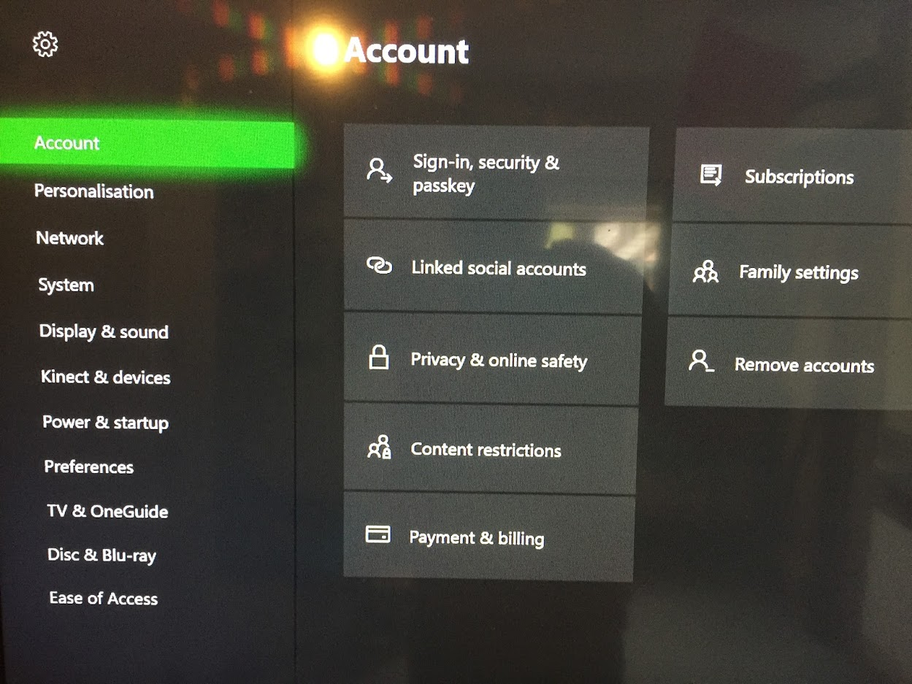
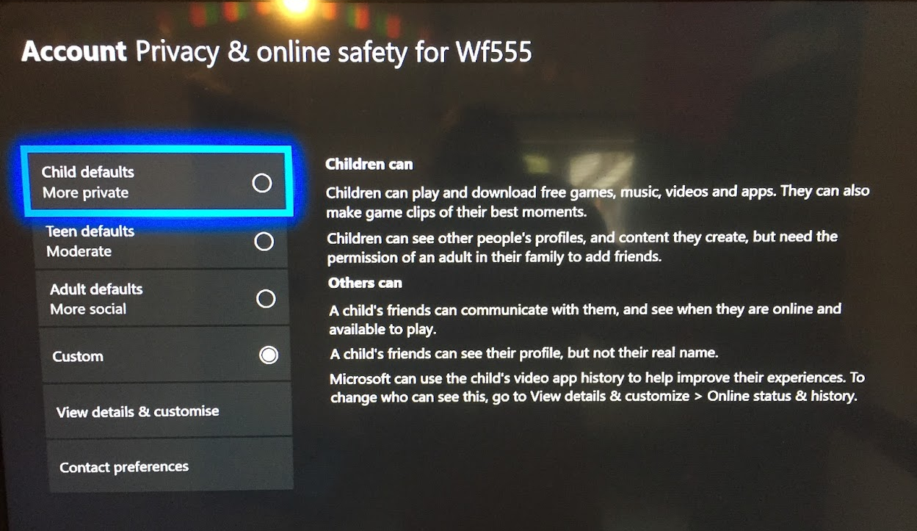
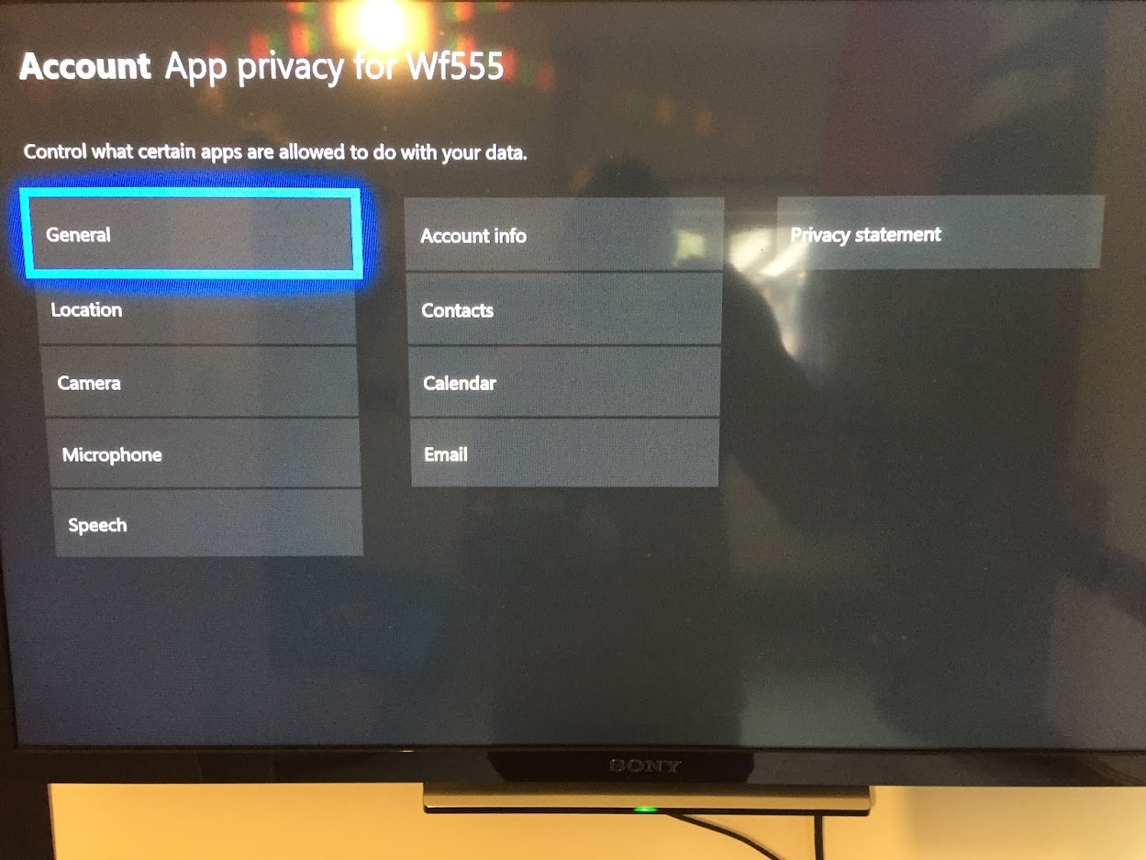
Device settings – xbox one

Slide 8
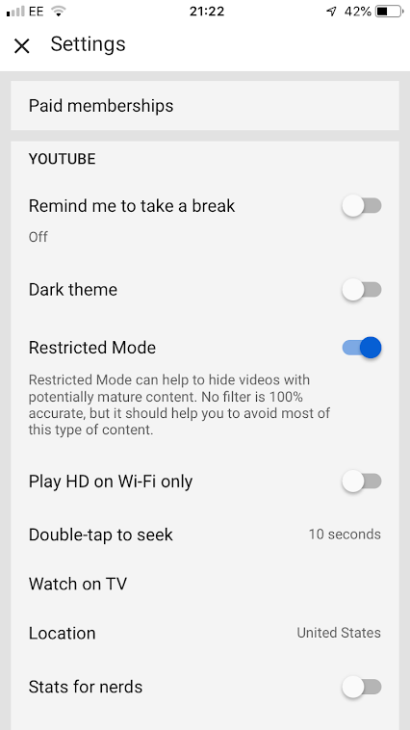
app settings
Applications – Privacy settings
Most apps also have their own content and restriction settings.
Check these settings also!
You tube
Facebook
instagram
Use child friendly apps where available.
You tube kids
Bbc iplayer kids
Sky kids
Disney club penguin
Minecraft pocket edition

Slide 9
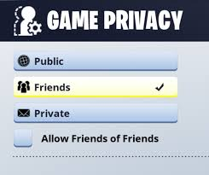
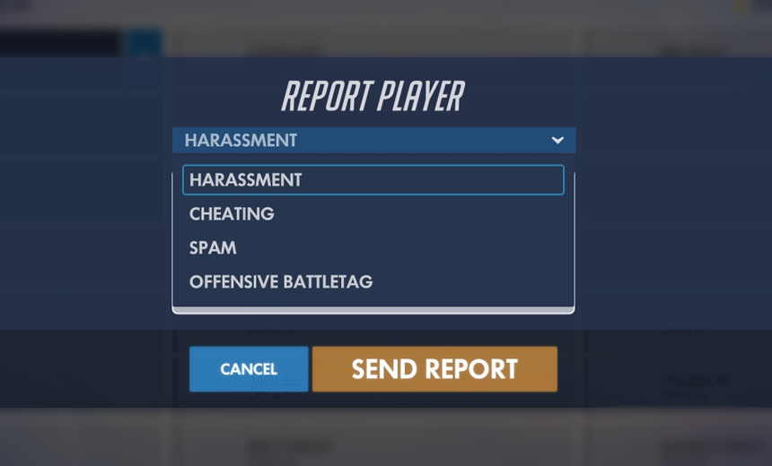
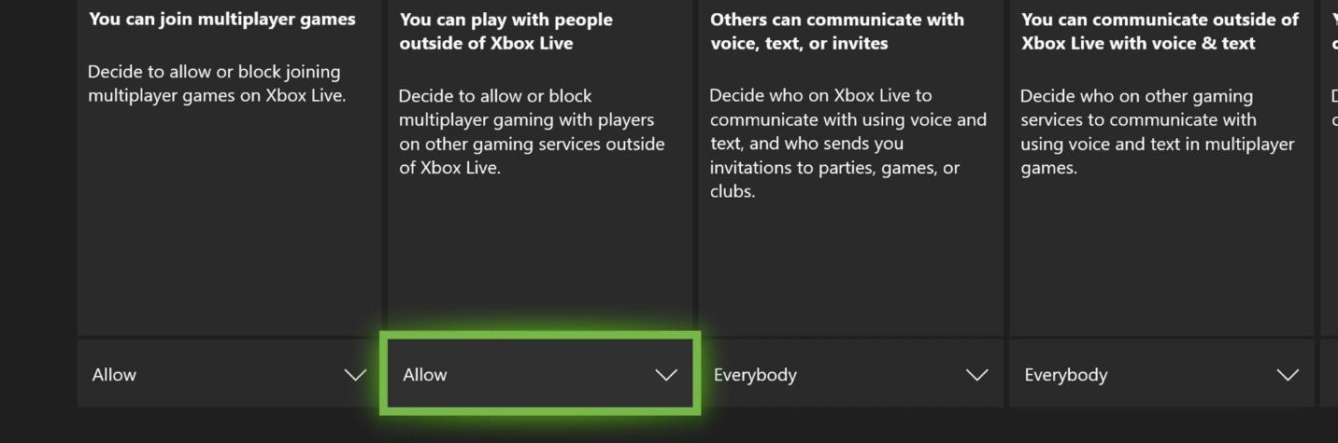
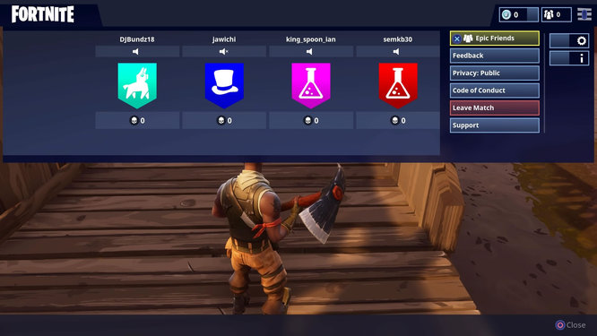
game settings
Fornite – Privacy settings
Fornite basic rules
Check the game privacy – show your child how to set this! – they can then show their fiends.
Set limits – games normally last about 20mins
Report players – remember their game tag!
The game is free – the cost comes in “v-bucks” and wanting “new” things in the shop.
Restrict purchases

Slide 10
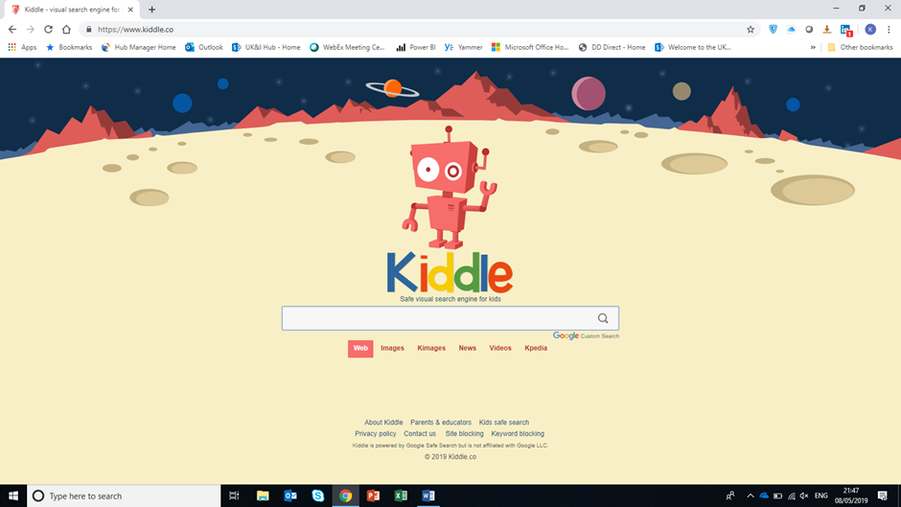
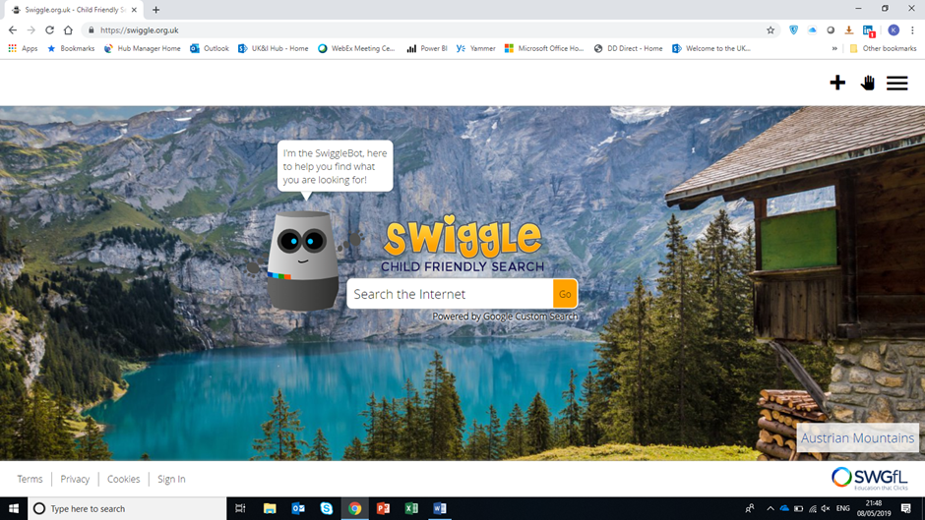
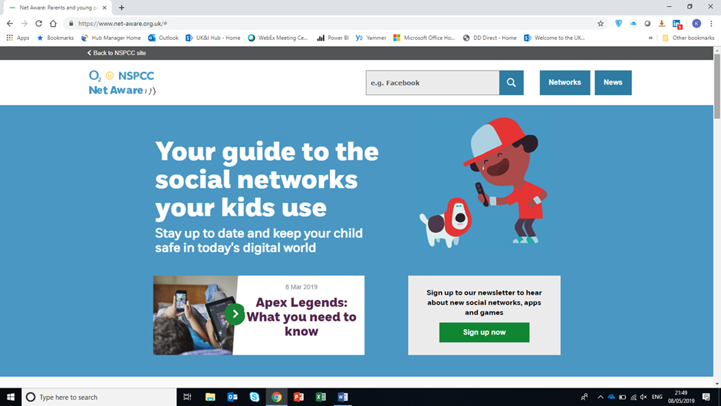
Useful websites
Kids safe search engines.
National online safety – good website for understanding the language and new craze of game
https://nationalonlinesafety.com/
NSPCC – good all round guides
https://www.net-aware.org.uk/#
https://www.nspcc.org.uk/preventing-abuse/keeping-children-safe/online-safety/

Slide 11
Things to remember ☺ 1 - communication! 2 - Updates! 3 – set limits!

